Slide 1

Software Engineering (CS-425) Project
Group members:
Surafel Teshome
Getaneh Yilma
Sodbileg Shirmen
Addisu Mekonnen

Slide 2
Vision
Online Platform which:
Allow users to search books
Accept order request from customers
Send delivery request for suppliers
Send notification to customers when delivery is initiated
Send notification to customers when products/new arrivals are available

Slide 3
Main use case: add to cart
Customer:
Select book of interest & add to shopping cart
System:
Enable customer to add books into shopping cart

Slide 4
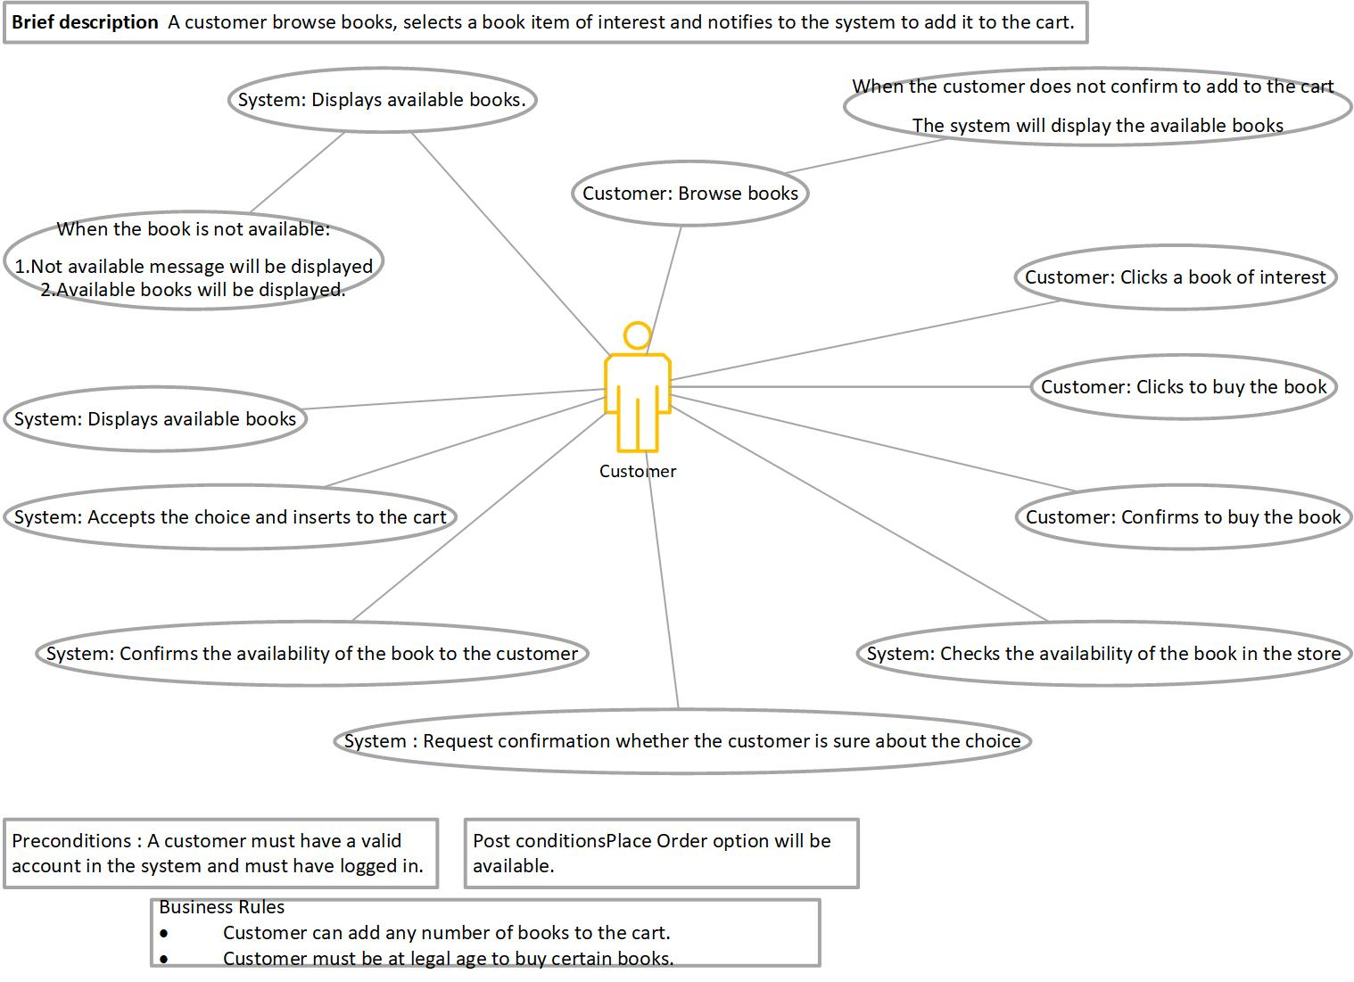
add to cart

Slide 5
Main use case: place Order
Customer:
Select book, add to shopping cart, place order and pay
System:
Initiates delivery request to suppliers

Slide 6
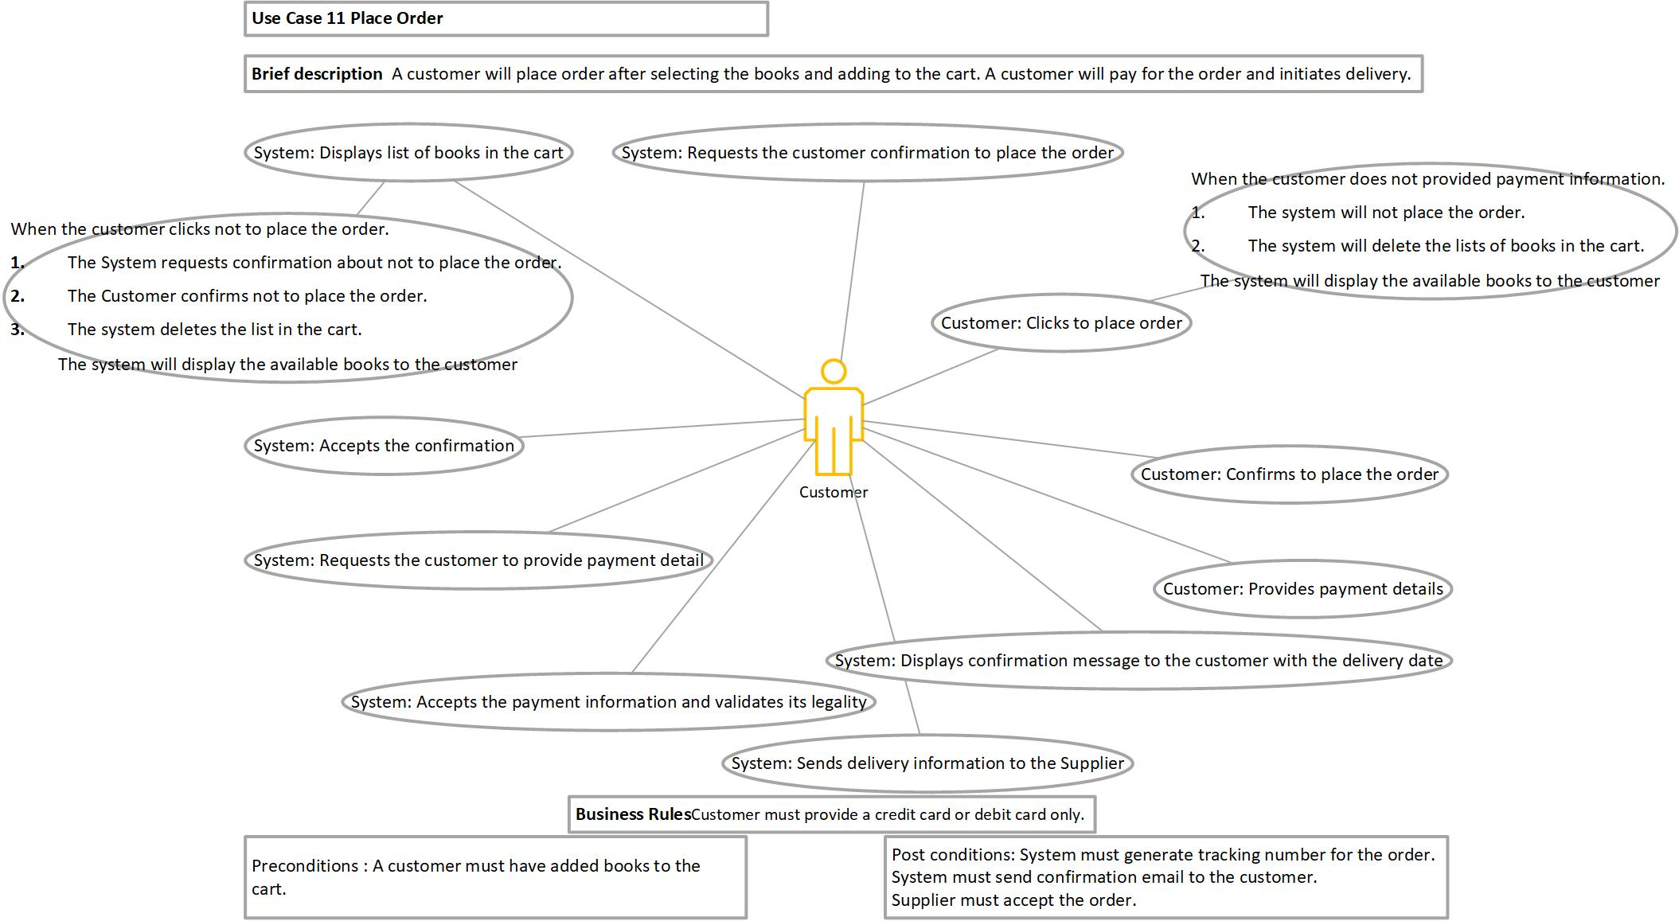
place order

Slide 7
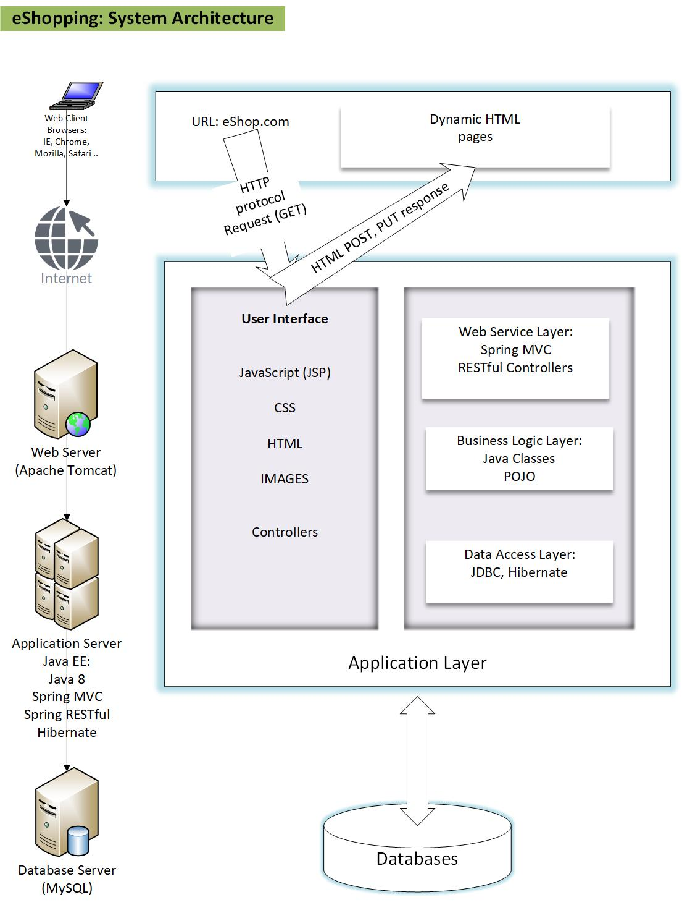

Slide 8
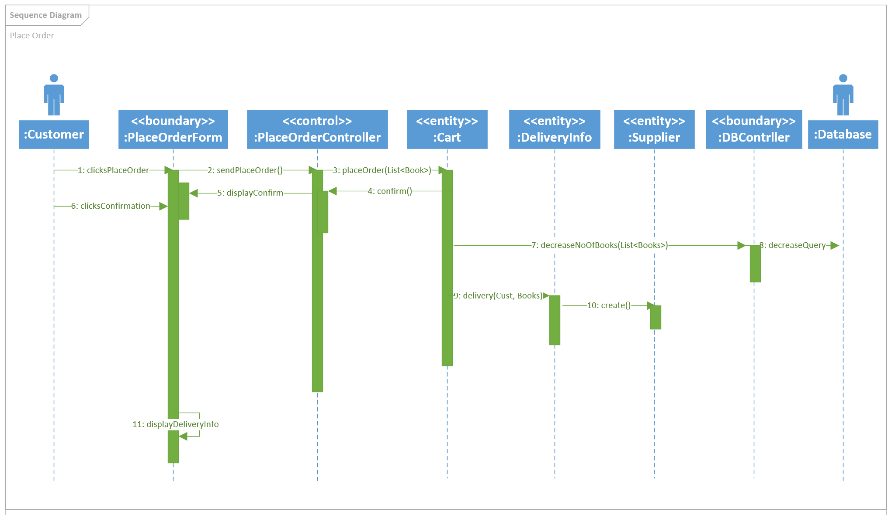
Main use case: place Order

Slide 9
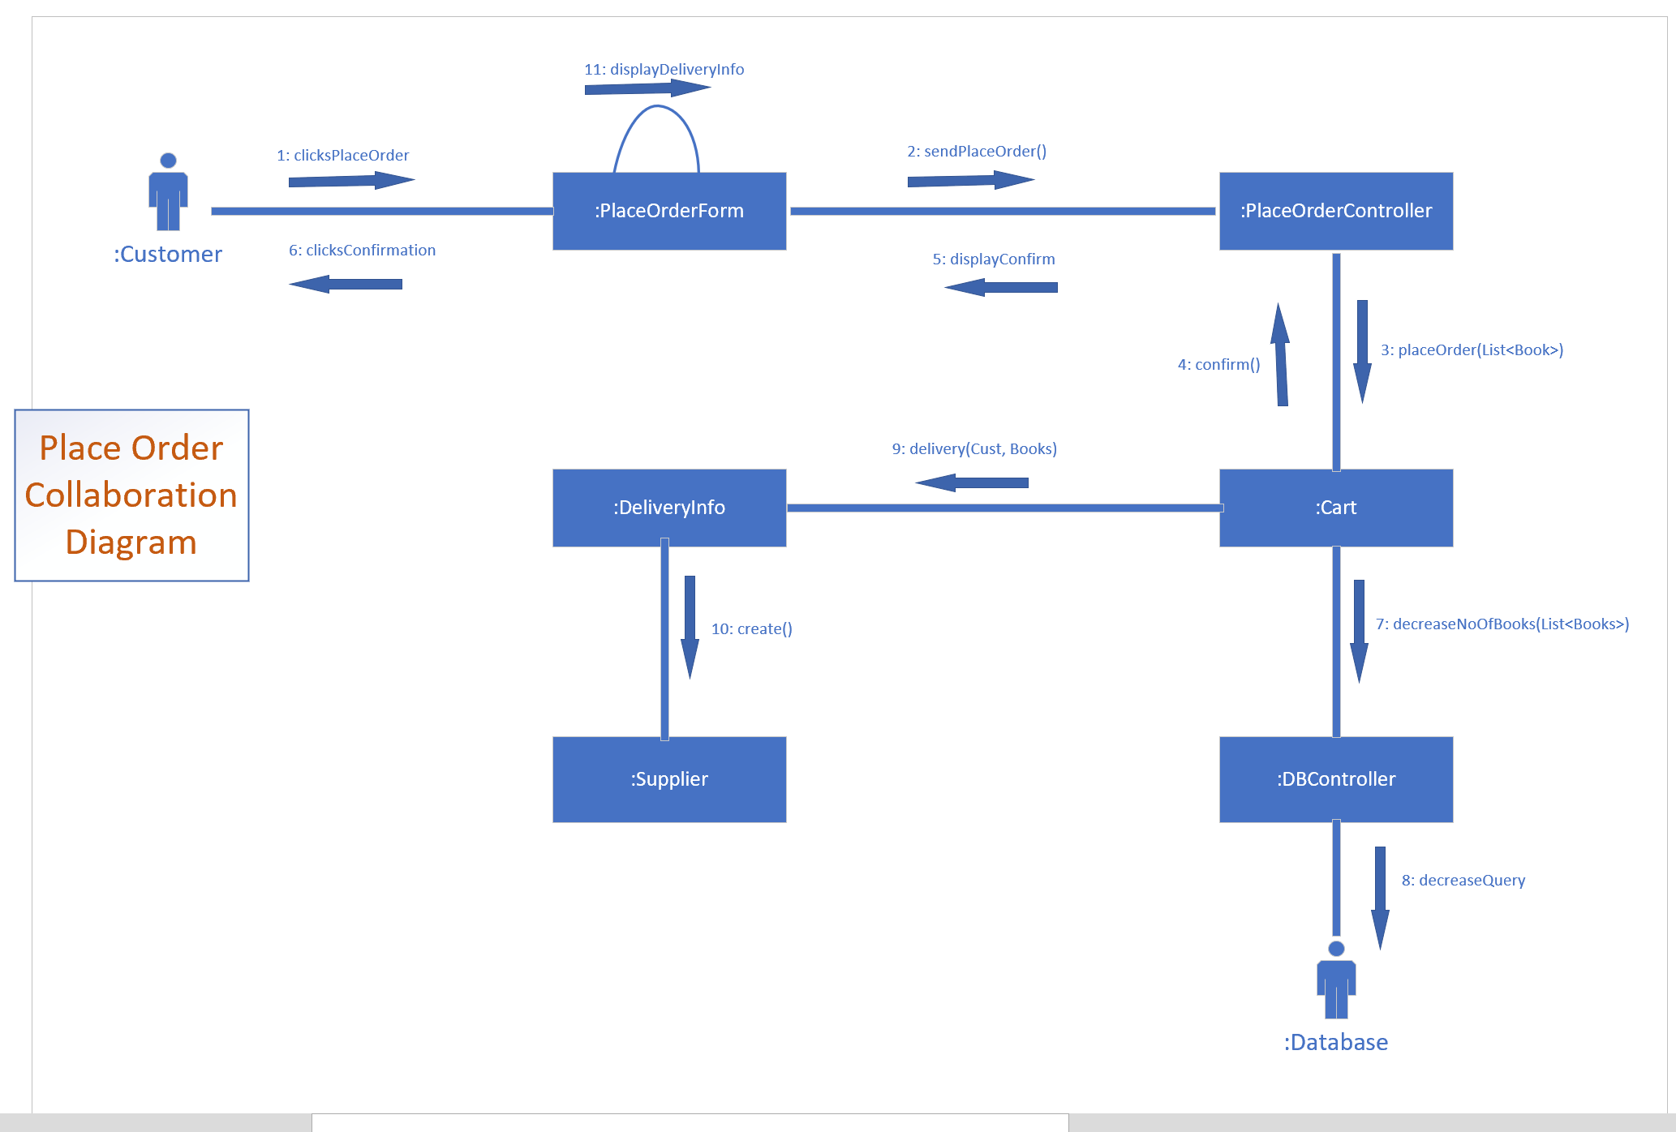
Main use case: place Order

Slide 10
Thank You!

